Slide 1


Implementing new physics in SPECFEM++
CIG Meeting, Breckenridge, 2025
Rohit Kakodkar, Congyue Cui, Lucas Sawade & Max Chien
Research Computing/Geosciences Department

Slide 2
Outline
Overall calling structure
Implement a new medium (general)
Implement medium specific physics (damping for poroelastic media)
New medium for SPECFEM users/developers: Cosserat Medium
Implement a new boundary condition (stacey for Cosserat)

Slide 3
SPECFEM Algorithm
Start
Define parameter file
Define sources
Define receivers
void time_loop() {
for (int istep : nstep) {
apply_predictor_phase_forward();
for (medium : medium_tags) {
update_wavefields<medium>();
}
apply_corrector_phase_forward();
}
}
Read the mesh
Generate assembly
Define global numbering scheme.
Define GLL level properties
Run solver
Execute the time loop
Write output

Slide 4







SPECFEM++ Architecture
Dirichlet
Medium
Property
Boundary
Elastic Isotropic
None
Acoustic
Elastic Isotropic
None
None
Acoustic Isotropic Dirichlet
Stacey
Isotropic
Elastic Isotropic
Stacey
Elastic
Acoustic Isotropic
Stacey
None
Stacey
Stacey
Notes:
medium tag

Slide 5
SPECFEM Algorithm
void time_loop() {
for (int istep : nstep) {
apply_predictor_phase_forward(); for (medium : medium_tags) {
update_wavefields<medium>();
}
apply_corrector_phase_forward();
// Run other periodic tasks..
}
}
template <specfem::element::medium_tag medium>
void update_wavefields() {
for (property, boundary : property_tags, boundary_tags) {
compute_coupling <medium, property>();
compute_source_interaction<medium, property>();
compute_stiffness_interaction<medium, property, boundary>();
divide_mass_matrix<medium, property>();
}
}
template<>
compute_source_interaction<elastic_psv, anisotropic>() {
// Implementation for elastic anisotropic medium
}
// etc.

Slide 6
SPECFEM Algorithm
template <medium_tag, property_tag, boundary_tag>
void compute_stiffness_interaction() {
if (nelements == 0) return;
for ispec, iz, ix in range(nelements, ngllz, ngllx) {
du = compute_gradient();
sigma = compute_stress<medium, property>(du);
F = compute_stress_integrand(sigma);
KU = compute_divergence(F);
BU = compute_BC<medium, property, boundary>();
acceleration = KU + BU;
}
}
template <>
T compute_stress<elastic_psv, isotropic>() {
sigma_xx = lambdaplus2mu() * du(0, 0) + lambda() * du(1, 1);
sigma_zz = lambdaplus2mu() * du(1, 1) + lambda() * du(0, 0);
sigma_xz = properties.mu() * (du(0, 1) + du(1, 0));
T(0, 0) = sigma_xx;
T(0, 1) = sigma_xz;
T(1, 0) = sigma_xz;
T(1, 1) = sigma_zz;
return { T };
}

Slide 7
Implementing a new medium
Preparation
Read the mesh
Bookkeeping
Physics implementation
Post-processing

Slide 8

Preparation
Define enumerations
Define properties
Define misfit kernels

Slide 9

Preparation
Define enumerations
medium.hpp
material_definitions.hpp
Define properties
Define misfit kernels

Slide 10
Preparation
Define enumerations
medium.hpp
material_definitions.hpp
enum class medium_tag {
elastic,
acoustic
};
Define properties
template <>
class attributes<dim2, elastic> {
public:
constexpr static int dimension() { return 2; }
// Number of components in field constexpr static int components() { return 2; }
};
Define misfit kernels

Slide 11
Preparation
Define enumerations
medium.hpp
material_definitions.hpp
#define ELEMENT_TYPES\
((DIM2, ELASTIC, ISOTROPIC, NONE))( \
(DIM2, ACOUSTIC, ISOTROPIC, NONE))( \
(DIM2, ELASTIC, ISOTROPIC, STACEY))( \
(DIM2, ACOUSTIC, ISOTROPIC, DIRICHLET))
Define properties
Define misfit kernels
void compute_forces() {
compute_forces_elastic_isotropic_none();
compute_forces_acoustic_isotropic_none();
compute_forces_elastic_isotropic_stacey();
compute_forces_acoustic_isotropic_dirichlet();
.
.
.
}

Slide 12
Preparation
Define enumerations
medium.hpp
material_definitions.hpp
#define ELEMENT_TYPES\
((DIM2, ELASTIC, ISOTROPIC, NONE))( \
(DIM2, ACOUSTIC, ISOTROPIC, NONE))( \
(DIM2, ELASTIC, ISOTROPIC, STACEY))( \
(DIM2, ACOUSTIC, ISOTROPIC, DIRICHLET))
Define properties
void compute_forces() {
FOR_EACH_IN_PRODUCT(
(DIMENSION_TAG(DIM2),
MEDIUM_TAG(ACOUSTIC,ELASTIC),
PROPERTY_TAG(ISOTROPIC),
BOUNDARY_TAG(NONE, STACEY, DIRICHLET)),
{
compute_forces<DIMENTION, MEDIUM, PROPERTY, BOUNDARY>();
}
);
}
Define misfit kernels
Notes:
UPDATE MACRO CALL!

Slide 13
Preparation
Define enumerations
7 lines
Define properties
3 - 10 lines
Define misfit kernels
3 - 10 lines

Slide 14
Read the mesh
Reads the MESHFEM2D mesh binary file line-by-line
Update the mesh reader
80 lines
Notes:
UPDATE add line that all currently supported media

Slide 15
Bookkeeping
Define element types
Update data containers
Add new sources
Add new receivers
Define properties
Define misfit kernels
Add wavefields

Slide 16
Bookkeeping
Define element types
Update data containers
Add new sources
FOR_EACH_IN_PRODUCT(
(DIMENSION_TAG(DIM2),
MEDIUM_TAG(ACOUSTIC,ELASTIC),
PROPERTY_TAG(ISOTROPIC),
BOUNDARY_TAG(NONE, STACEY, DIRICHLET)),
{
create_data_container<...>
}
Add new receivers
Define properties
Define misfit kernels
Add wavefields

Slide 17
Bookkeeping
Define element types
DATA_CONTAINER(kappa, mu, rho)
Update data containers
Elastic isotropic
Add new sources
DATA_CONTAINER(c11, c13, c15, c33, c35, c55, c12, c23, c25, rho)
Add new receivers
Elastic anisotropic
Define properties
Define misfit kernels
Add wavefields

Slide 18
Bookkeeping
Define element types
21 lines†
Update data containers
4 lines†
Add new sources
14 lines†
Add new receivers
6 lines†
Define properties
10 – 20 lines
Define misfit kernels
10 – 20 lines
Add wavefields
7 lines†

Slide 19
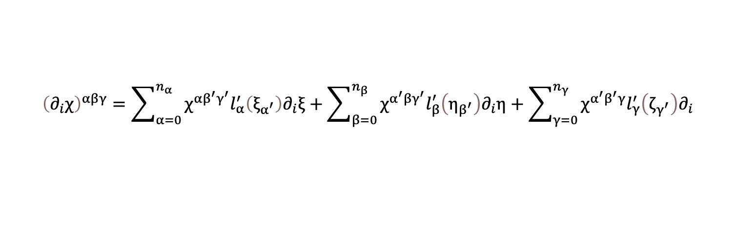
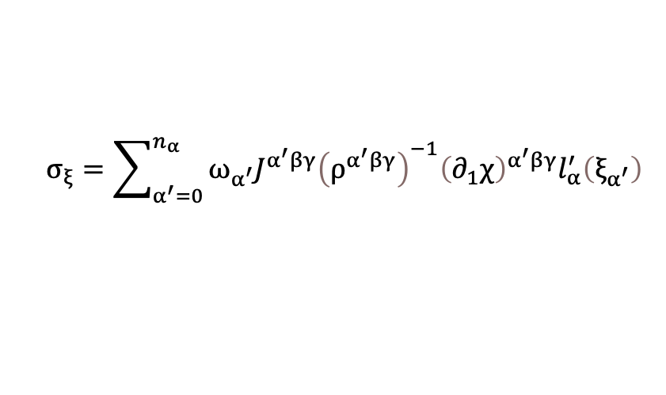
Physics Implementation
$$\int_{Ω_{e}}{ρ^{−1}∇w}⋅∇χdV≈\sum_{α,β,γ=0}^{n_{α},n_{β},n_{γ}}{w^{αβγ}\left[ω_{β}ω_{γ}σ_{ξ}+ω_{α}ω_{γ}σ_{η}+ω_{α}ω_{β}σ_{ζ}\right]}$$
$$σ_{ξ}=\sum_{α^{′}=0}^{n_{α}}{ω_{α^{′}}J^{α^{′}βγ}{\left(ρ^{α^{′}βγ}\right)}^{−1}{\left(∂_{1}χ\right)}^{α^{′}βγ}l_{α}^{′}\left(ξ_{α^{′}}\right)}$$
$${\left(∂_{i}χ\right)}^{αβγ}=\sum_{α=0}^{n_{α}}{χ^{αβ^{′}γ^{′}}l_{α}^{′}\left(ξ_{α^{′}}\right)∂_{i}ξ}+\sum_{β=0}^{n_{β}}{χ^{α^{′}βγ^{′}}l_{β}^{′}\left(η_{β^{′}}\right)∂_{i}η}+\sum_{γ=0}^{n_{γ}}{χ^{α^{′}β^{′}γ}l_{γ}^{′}\left(ζ_{γ^{′}}\right)∂_{i}}$$
specfem::datatype::VectorPointViewType<type_real, 2, 1, UseSIMD> T;
T(0, 0) = properties.rho_inverse * du(0, 0);
T(1, 0) = properties.rho_inverse * du(1, 0);
return { T };
Notes:
Element stiffness matrix given gradients.
We compute the stress using a constitutive law from the strain.

Slide 20
Physics Implementation
Compute mass matrix
specfem::datatype::VectorPointViewType<type_real, 2, 1, UseSIMD> T;
T(0, 0) = properties.rho_inverse * du(0, 0);
T(1, 0) = properties.rho_inverse * du(1, 0);
return { T };
Compute stress
Acoustic stress
datatype sigma_xx, sigma_zz, sigma_xz;
sigma_xx = properties.lambdaplus2mu * du(0, 0) + properties.lambda * du(1, 1);
sigma_zz = properties.lambdaplus2mu * du(1, 1) + properties.lambda * du(0, 0);
sigma_xz = properties.mu * (du(0, 1) + du(1, 0));
specfem::datatype::VectorPointViewType<type_real, 2, 2, UseSIMD> T;
T(0, 0) = sigma_xx;
T(0, 1) = sigma_xz;
T(1, 0) = sigma_xz;
T(1, 1) = sigma_zz;
Compute source interaction
Compute seismograms
Update the timescheme
Elastic stress
Notes:
stress given gradients

Slide 21
Post processing
Write models
Write misfit kernels
Write seismograms

Slide 22
Summary
Preparation
Read the mesh
Bookkeeping
Physics implementation
Post-processing
~400 lines
Electromagnetic implementation compute forces only: ~300 lines
CPU ONLY

Slide 23
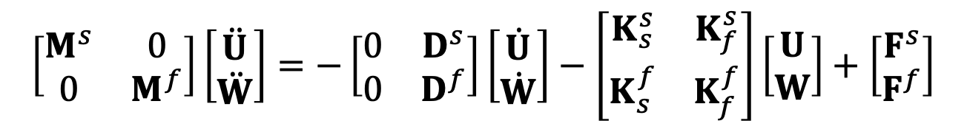
Damping for Poroelasticity
$$\left[\begin{matrix}M^{s} & 0 \\ 0 & M^{f}\end{matrix}\right]\left[\begin{matrix}\ddot{U} \\ \ddot{W}\end{matrix}\right]=−\left[\begin{matrix}0 & D^{s} \\ 0 & D^{f}\end{matrix}\right]\left[\begin{matrix}\dot{U} \\ \dot{W}\end{matrix}\right]−\left[\begin{matrix}K_{s}^{s} & K_{f}^{s} \\ K_{s}^{f} & K_{f}^{f}\end{matrix}\right]\left[\begin{matrix}U \\ W\end{matrix}\right]+\left[\begin{matrix}F^{s} \\ F^{f}\end{matrix}\right]$$
template <medium_tag, property_tag, boundary_tag>
void compute_stiffness_interaction() {
if (nelements == 0) return;
for ispec, iz, ix in range(nelements, ngllz, ngllx) {
du = compute_gradient();
sigma = compute_stress<medium, property>(du);
F = compute_stress_integrand(sigma);
acceleration += compute_divergence(F); acceleration += compute_BC<medium, property, boundary>();
acceleration += compute_damping_force<medium, property> (...);
}
}
void compute_damping_force() {
// viscous damping
const auto viscx = ...
const auto viscz = ...
// Update acceleration
acceleration(0) += ... * viscx;
acceleration(1) += ... * viscz;
acceleration(2) -= viscx;
acceleration(3) -= viscz;
}
Notes:
For

Slide 24
Damping for Poroelasticity
Compile-time conditional dispatch
void compute_damping(vel, acc, properties) {
medium_tag = properties.medium_tag;
attributes<medium_tag>::has_damping_force has_damping_force;
bool_type = std::integral_constant<bool, has_damping_force>;
impl::compute_damping_force(
bool_type(), properties, vel, acc);
return;
}
void impl::compute_damping_force(
false_type(), properties, vel, acc) {
return;
}
void impl::compute_damping_force(
true_type(), vel, acc, properties
) {
// viscous damping
const auto viscx = ...
const auto viscz = ...
// Update acceleration
acceleration(0) += ... * viscx;
acceleration(1) += ... * viscz;
acceleration(2) -= viscx;
acceleration(3) -= viscz;
}

Slide 25
Damping for Poroelasticity
Compile-time conditional dispatch
void time_loop() {
for (int istep : nstep) {
apply_predictor_phase_forward();
for (medium : medium_tags) {
update_wavefields<medium>();
}
apply_corrector_phase_forward();
}
}
void compute_damping(vel, acc, properties) {
medium_tag = properties.medium_tag;
attributes<medium_tag>::has_damping_force has_damping_force;
bool_type = std::integral_constant<bool, has_damping_force>;
impl::compute_damping_force(
bool_type(), properties, vel, acc);
return;
}
void impl::compute_damping_force(
false_type(), properties, vel, acc) {
return;
}
Notes:
What

Slide 26
Damping for Poroelasticity
Compile-time conditional dispatch
update_wavefield<elastic_psv>()
update_wavefield<poroelastic>()
compute_damping(..)
Notes:
What

Slide 27
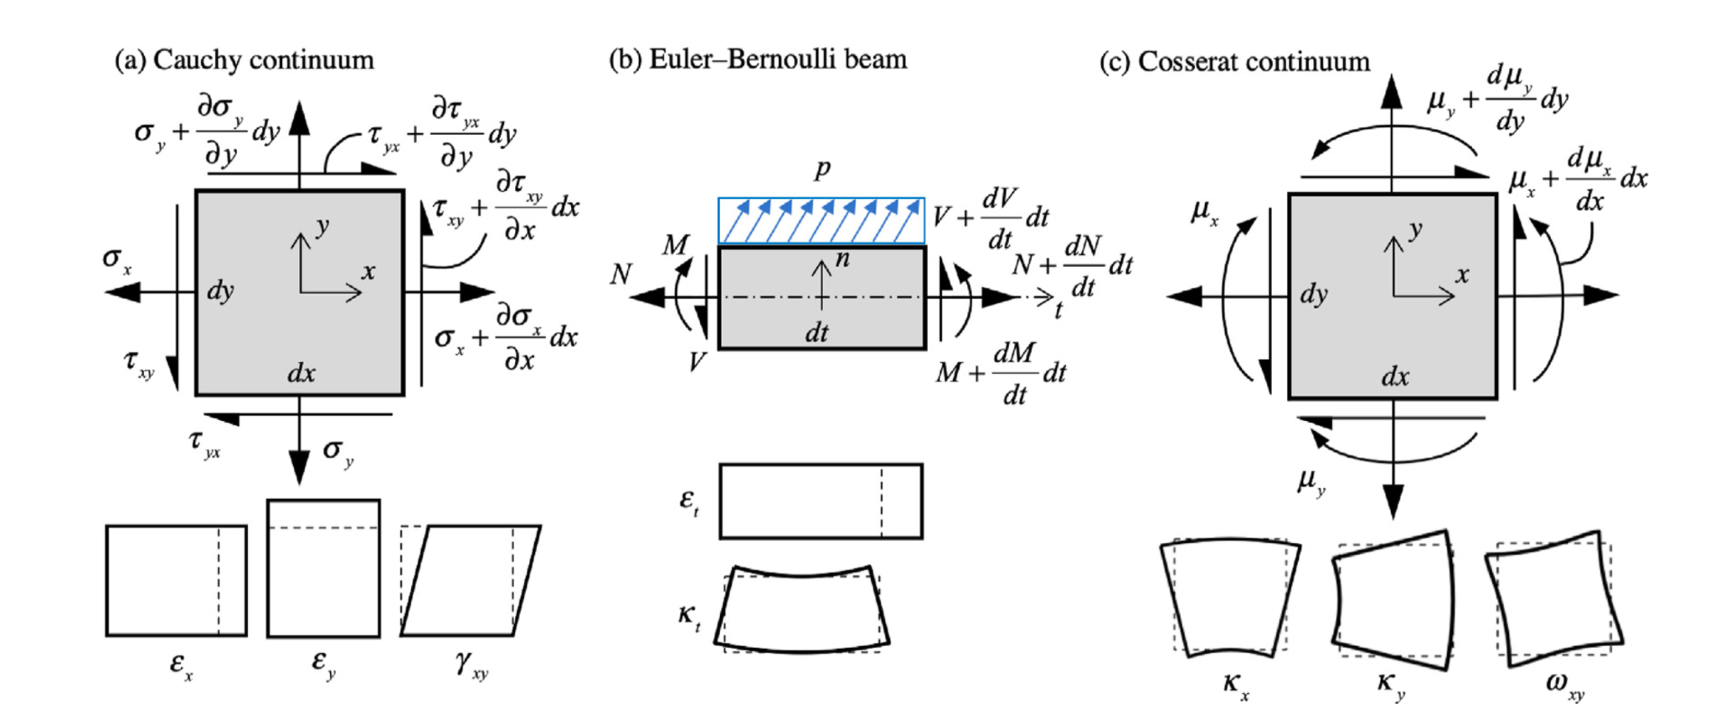
Cosserat Media
Molnár and Blal (2023)

Slide 28
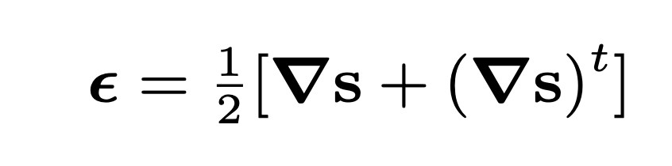
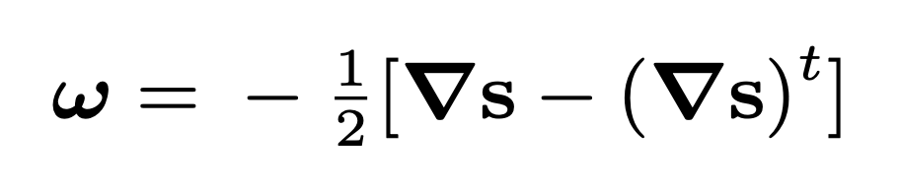
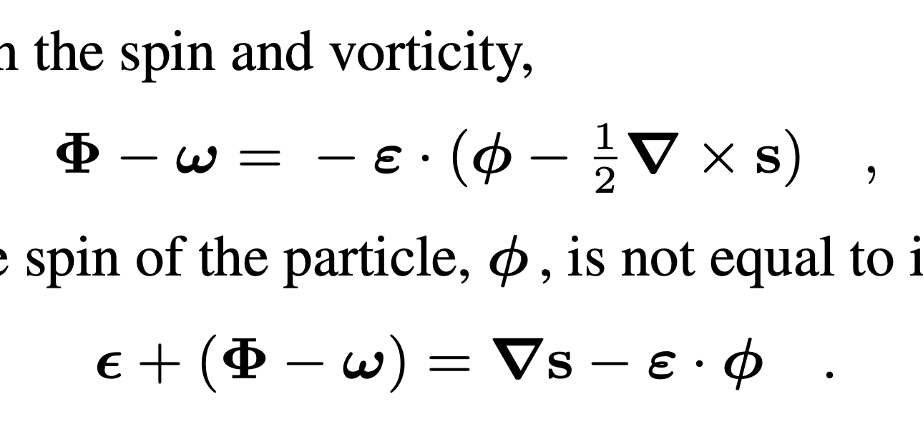
Cosserat Media
Spin - Vorticity
Total Strain

Slide 29
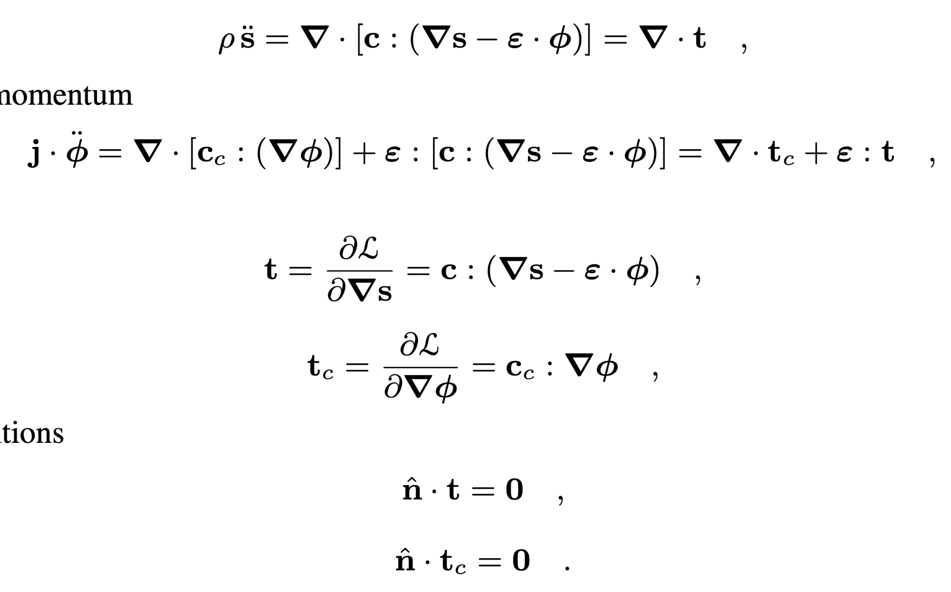
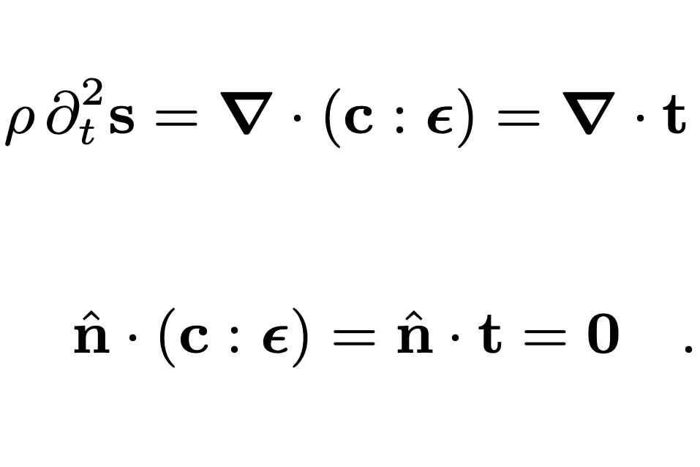
Cosserat Media
Classic elastic medium
Cosserat medium

Slide 30
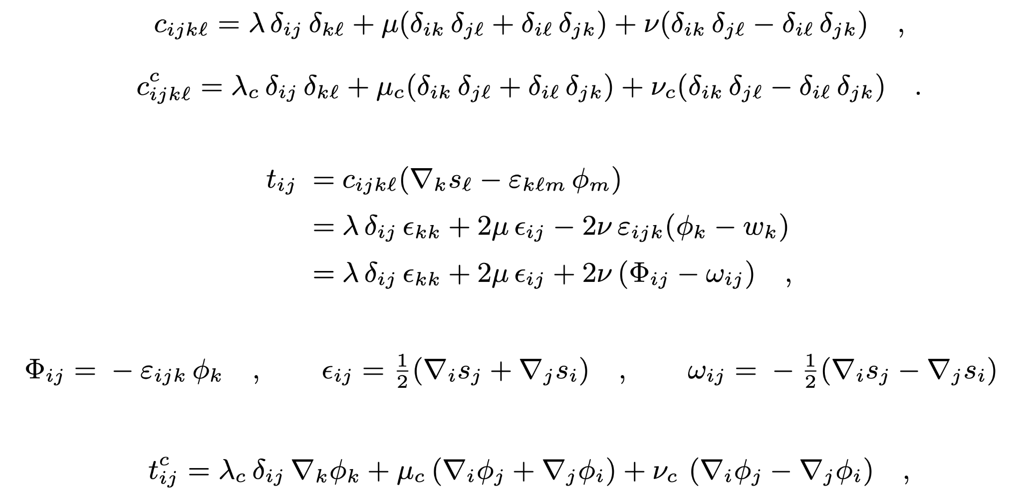
Isotropic Cosserat Media

Slide 31
Cosserat Stress Implementation
x,z
T compute_stress<specfem::element::medium_tag::elastic_psv_t>(du, properties)
{
datatype sigma_xx, sigma_xz, sigma_zx, sigma_zz, sigma_c_xy, sigma_c_zy;
sigma_xx = lambda * (du(0, 0) + du(1, 1)) + 2.0 * mu * du(0, 0);
sigma_zz = lambda * (du(0, 0) + du(1, 1)) + 2.0 * mu * du(1, 1);
sigma_xz = mu * (du(1, 0) + du(0, 1)) + nu * (du(1, 0) - du(0, 1));
sigma_zx = mu * (du(0, 1) + du(1, 0)) + nu * (du(0, 1) - du(1, 0));
sigma_c_xy = (mu_c + nu_c) * du(2, 0);
sigma_c_zy = (mu_c + nu_c) * du(2, 1);
T(0, 0) = sigma_xx;
T(1, 0) = sigma_xz;
T(0, 1) = sigma_zx;
T(1, 1) = sigma_zz;
T(2, 0) = sigma_c_xy;
T(2, 1) = sigma_c_zy;
return { T };
}
y only

Slide 32
Cosserat Stress Implementation
x,z
void compute_cosserat_stress<elastic_psv_t>(T, u, nu) { T(0, 1) -= 2.0 * nu * u(2);;
T(1, 0) += 2.0 * nu * u(2); return;
};

Slide 33
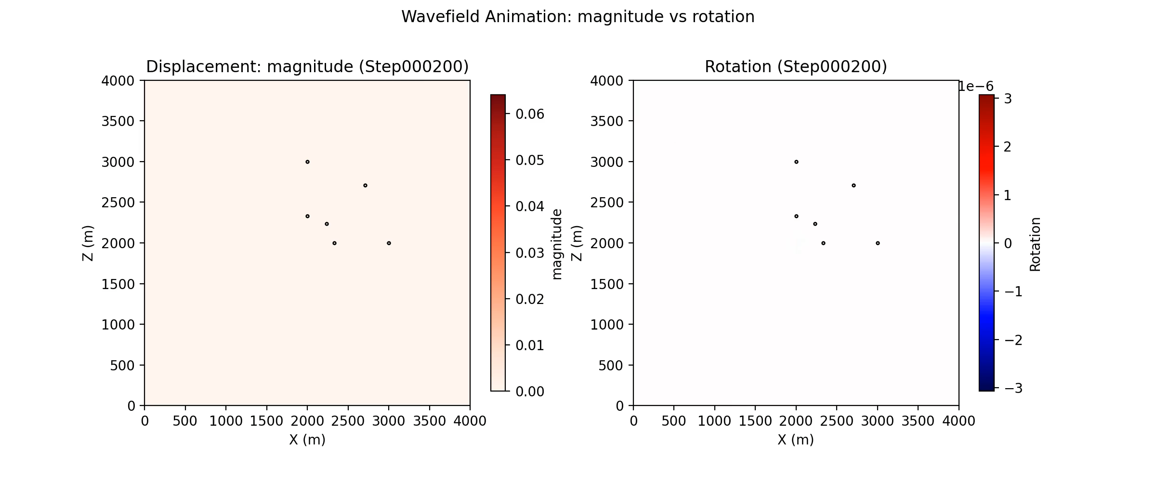
Cosserat Medium Simulation
Simulation from Max Chien

Slide 34
Implement Stacey ABC
void enforce_traction<elastic_psv>() {
vn = dot(velocity, edge_normal);
temp1 = vn / (jacobian1d * jacobian1d) * (rho_vp - rho_vs);
temp2 = jacobian1d * edge_weight;
traction(0) -= (temp1 * edge_normal(0) + velocity(0) * rho_vs) * temp2;
traction(1) -= (temp1 * edge_normal(1) + velocity(1) * rho_vs) * temp2;
return;
}
Derivations by Max Chien
template<>
void enforce_traction<elastic_psv_t>() {
vn = velocity(0) * edge_normal(0) + velocity(1) * edge_normal(1);
rho_vs = rho * sqrt((mu + nu) / rho);
j_vt = j * sqrt((mu_c + nu_c) / j);
temp1 = vn / (jacobian1d * jacobian1d) * (rho_vp - rho_vs);
temp2 = jacobian1d * edge_weight;
traction(0) -= factor[0] * (temp1 * edge_normal(0) + velocity(0) * rho_vs) * temp2;
traction(1) -= factor[1] * (temp1 * edge_normal(1) + velocity(1) * rho_vs) * temp2;
traction(2) -= factor[2] * (j_vt * velocity(2)) * temp2; return;}

Slide 35

Implement Stacey ABC
Simulation from Max Chien

